Slide 1

Ratings Prediction Project

Slide 2


Slide 3
Abstract :-
The purpose of this analysis is to make up a prediction model where we will be able to predict whether a recommendation is positive or negative. In this analysis, we will not focus on the Score, but only the positive/negative sentiment of the recommendation.
Sentiment analysis of product reviews, an application problem, has recently become very popular in text mining and computational linguistics research. Here, we want to study the correlation between the Amazon product reviews and the rating of the products given by the customers.
As online marketplaces have been popular during the past decades, the online sellers and merchants ask their purchasers to share their opinions about the products they have bought. As a result, millions of reviews are being generated daily which makes it difficult for a potential consumer to make a good decision on whether to buy the product. Analysing this enormous amount of opinions is also hard and time consuming for product manufacturers. This thesis considers the problem of classifying reviews by their overall semantic (positive or negative).

Slide 4
Problem Statement
We have a client who has a website where people write different reviews for technical products. Now they are adding a new feature to their website i.e. The reviewer will have to add stars(rating) as well with the review. The rating is out 5 stars and it only has 5 options available 1 star, 2 stars, 3 stars, 4 stars, 5 stars. Now they want to predict ratings for the reviews which were written in the past and they don’t have a rating. So, we have to build an application which can predict the rating by seeing the review.

Slide 5
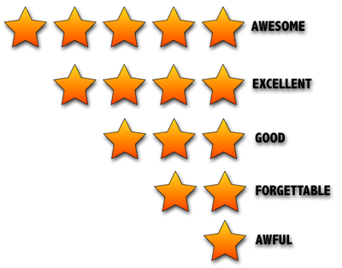
Problem Understanding
The user feedback information based Collaborative Filtering algorithm is often used to discover the hidden preferences of users and potential features of items in Recommender System for the past few years. Nevertheless, the potential relationship between different users is often ignored in the current Collaborative Filtering algorithm which contained in the user feedback information. The study indicates that user reviews and ratings will directly affect the sales of the product. Customer before buying check the reviews of that product and decide whether to buy it or not.

Slide 6
Introduction:- Business Problem
We have a client who has a website where people write different reviews for technical products. Now they are adding a new feature to their website i.e. The reviewer will have to add stars(rating) as well with the review. The rating is out 5 stars and it only has 5 options available 1 star, 2 stars, 3 stars, 4 stars, 5 stars. Now they want to predict ratings for the reviews which were written in the past and they don’t have a rating. So, we have to build an application which can predict the rating by seeing the review.

Slide 7
Importance of Rating Prediction
Rating prediction is an important technology in the personalized recommendation field. Prediction results are influenced by many factors, such as time, and their accuracy directly affects the quality of the recommendation.
In order to predict review rating considering the features embedded in the reviews. Sentiment of review considered one of the most valuable features that could be utilized to properly solve the task at hand better. Doing so would lead to more reliable ratings prediction and assist users to make the right options.

Slide 8

What is RATING PREDICTION?
Rating prediction is a well-known recommendation task aiming to predict a user's rating for those items which were not rated yet by her. Predictions are computed from users' explicit feedback, i.e. their ratings provided on some items in the past.

Slide 9
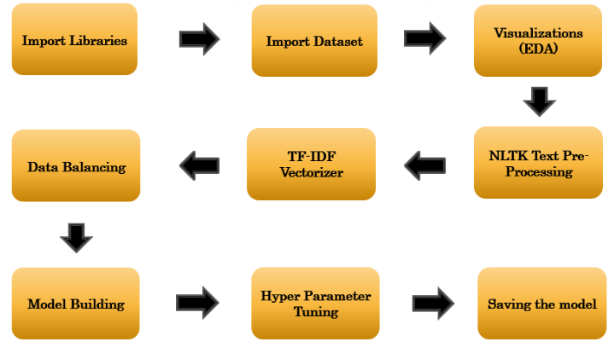
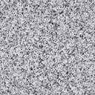
Model Building Flow Chart

Slide 10
Exploratory Data Analysis
Importing necessary libraries and loading the dataset.
Checking the shape of data, unique value, statistical summary of data, count of data etc.
Checking the null value and replace the missing value with mode. Removed the column Unnamed: 0 from the dataset.
Visualized the ratings using the seaborn and matplotlib libraries.
We have done the text data pre-processing, removed the stop words, punctuation, character and words splitting into different column and check the count of words and character. Using the Stemming and Lemmatizer.
We have converted the text into vector using the TF-IDF Vectorizer. Vectors can be put as input and used in the training and testing the model.
Balanced the target variable ratings using the Over sampling technique SMOTE.

Slide 11
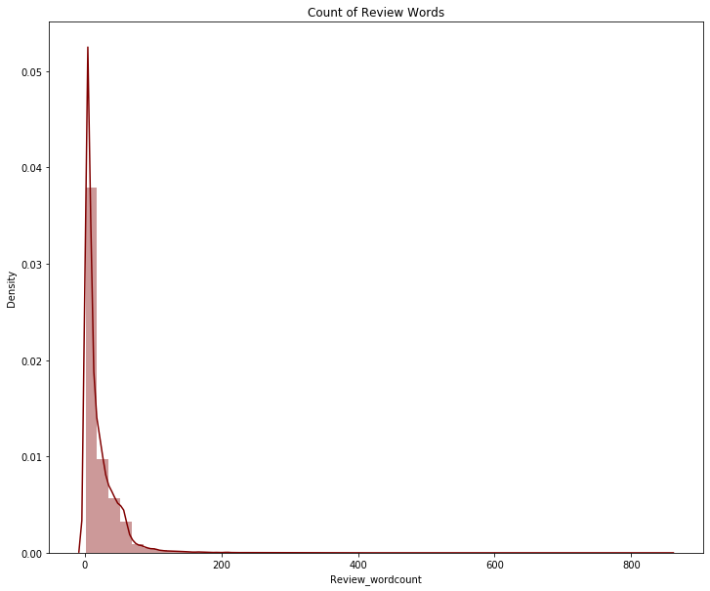
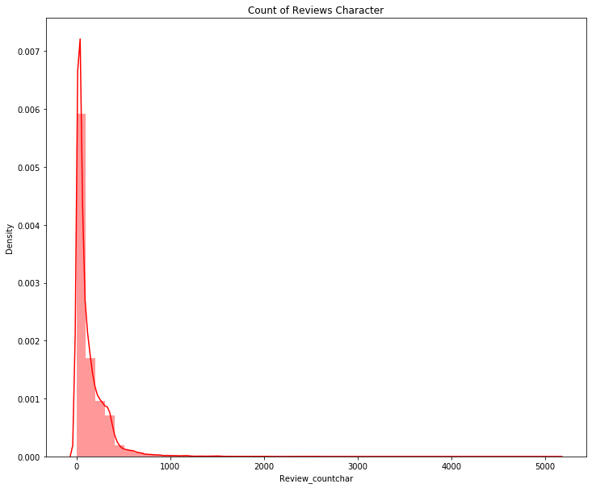
Visualization
In the above distribution plot the word count lies in the range 0-200 and character count lies in the range 0-1000. Most of the reviews range is length that can act as an outliers in the dataset

Slide 12
Observation
In this project the main purpose is to explore the data, feature engineering and classification. As the data is huge we can explore it more deeply by analysis the data set. In the review it contains lots of stop words, punctuation, short words. Removed those from the review to make it simple and more accuracy.
Using the TF-IDF Vectorizer I have converted the text data into vector. That can be used as input for building the model. We have used word cloud to visualize the frequently used words..
Removed the symbols, url from review using the regular expression.
As the dataset contains the outliers, we have removed the outliers using the zscore method.
Balanced the data using the oversampling technique SMOTE.
Finally we have build the machine learning model to train and test the data.

Slide 13
Conclusion
In this project I have used a NLP Machine learning algorithm to predict the Rating Prediction. We have analyse the model using the visualization tool using the count plot, distribution plot, heatmap, word cloud.
Removed the stop words, punctuations, URL, unnecessary words from Reviews. Data cleaning is the most important steps in any machine learning model. We have cleaned the data by removing the outliers using the zscore method.
We have converted the text into vector using the TFIDF Vectorizer. Balanced the data using the over sampling technique SMOTE.
We have splitted the data into feature(x) and target(y) variable. Then we have trained and test the data by giving the 70% of data for training and 30% of data for testing. We have used various machine learning model and compare other model. Choose the best model which performed well and gives a good accuracy. We have done the cross validation score for all our models. In this project Random Forest Classifier gives a good accuracy and it performed well.
Then we have done the hyper parameter tuning to check if we can increase our accuracy further.
Finally we have saved the model using the pickle and predicted the ratings. The predicted and actual value almost gives the same output. Our model has performed well.
With this prediction it helps the customer to choose the product wisely and also help to grow the business to understand the customers likes and dislike. What customer needs from Product. Based on that business can focus on those area to give a better customer service.

Slide 14


